Slide 1
Trends in the periodic table

Slide 2
Pre-reading
Pearson 3.3
Lucarelli Chapter 9
STAWA Set 11
STAWA Set 1-3

Slide 3
Trends
Valence Shell Electrons
Atomic Radius
Ionisation Energy
Electronegativity
(Electron affinity)

Slide 4
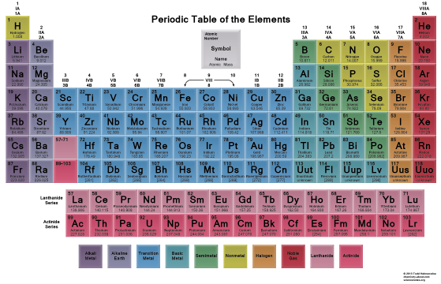

Slide 5
Trends in the Periodic Table

Slide 6
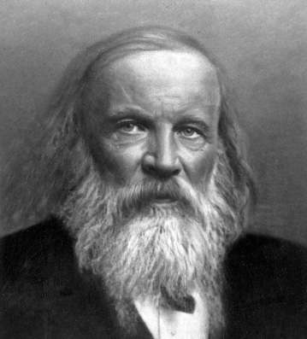
Development of the Periodic Table
The periodic table was invented by Dimitri Mendeleev (1869).
He arranged elements in order of increasing atomic mass, and noted that their properties e.g. Melting point, boiling point and density were periodic in nature (repeating patterns existed). .
Those elements with similar properties were placed below one another in groups and gaps were left for unknown elements.

Slide 7
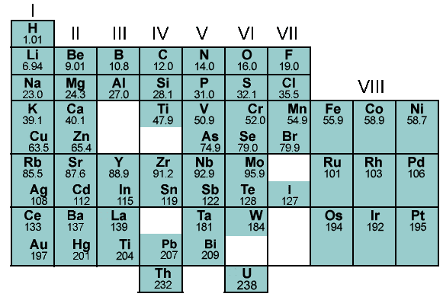
Mendeleev’s Periodic Table

Slide 8
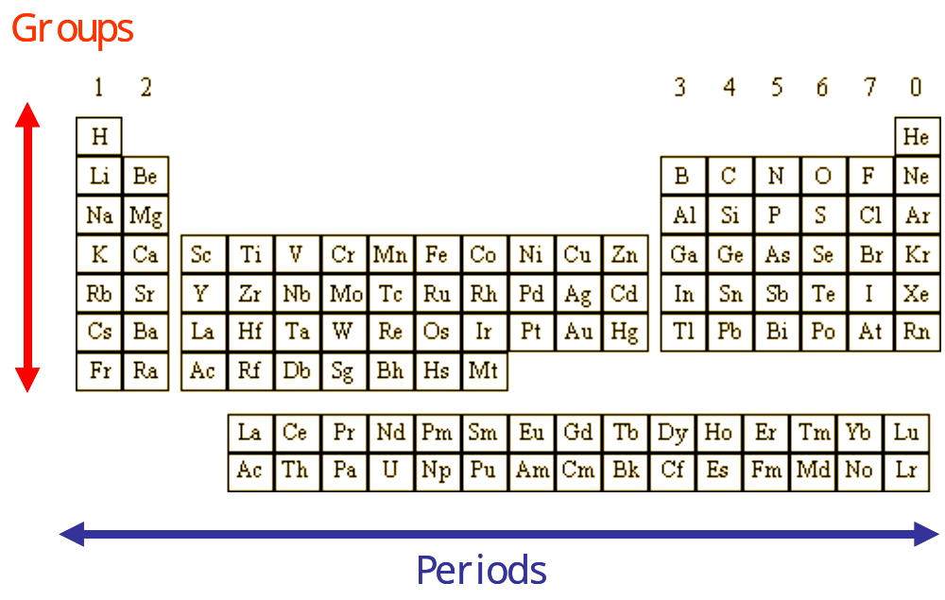
The Modern Periodic Table
The modern periodic table is based on an elements atomic number, and this removed a number of the anomalies in the original version.

Slide 9
Trends in Physical Properties of the Elements
Atomic Size
There is no definite
edge to an atom.
However, bond lengths
can be worked out.
Covalent radius gives us a measure of atomic size. It is defined as half the distance between the centres (nuclei) of 2 bonded atoms. The covalent radius is measured in picometres.
pm = picometre X 10 ^{– 12} m
N.B. To find the bond length, add 2 covalent radii together.

Slide 10
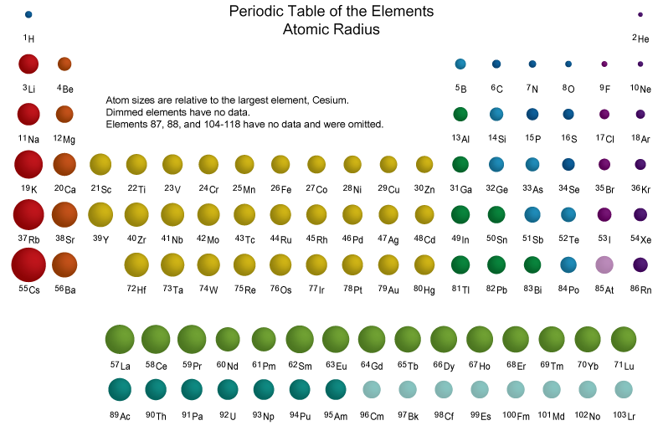

Slide 11
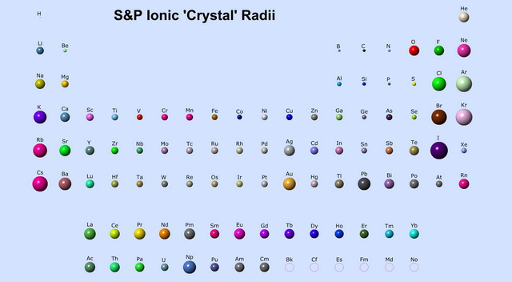

Slide 12
Atomic Size & Covalent Radius
As we go across a period, the nuclear charge and the number of outer electrons increase.
As we go down a group, the number of electron shells or energy levels increases but the number of outer electrons stays the same.
The trends in atomic size (as measured by covalent radius) in the periodic table are:
  Across a period the atomic size (covalent radius) decreases as the nuclear charge increases and attracts the outer electrons closer to the nucleus.
  Down a group the atomic size (covalent radius) increases as an extra electron shell is added.

Slide 13
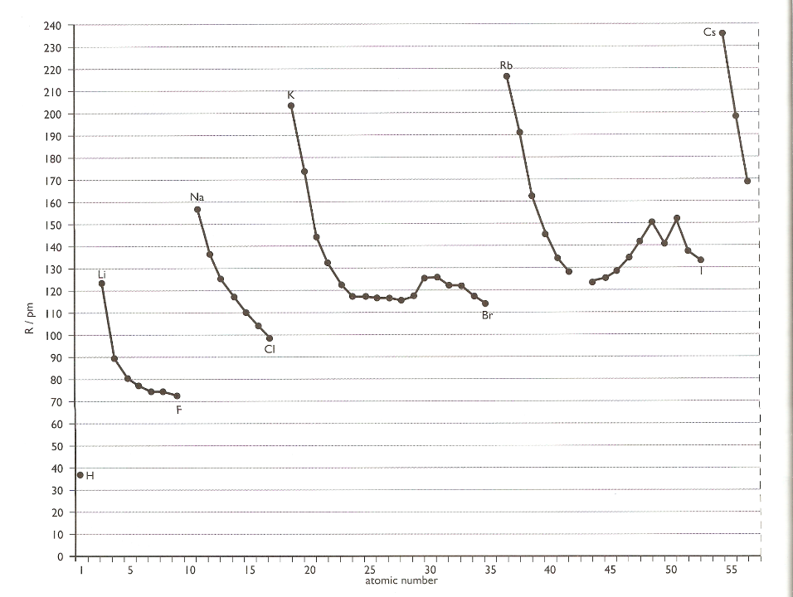








Variation of covalent radius with atomic number
Adapted from New Higher Chemistry E Allan J Harris
The covalent radii of the elements in
any period decrease with increasing atomic number.

Slide 14

Variation of covalent radius with atomic number
Adapted from New Higher Chemistry E Allan J Harris
The covalent radii of the elements in
any group increase with increasing atomic number.

Slide 15
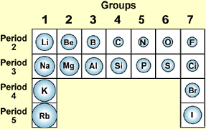
Covalent radius
Trends in Physical Properties of the Elements

Slide 16
First Ionisation Energy
Trends in Physical Properties of the Elements
This is defined as "the amount of energy required to remove one mole of electrons from one mole of atoms in the gaseous state”
Energy
M _{(g)} ➔ M⁺_{(g)} + e 1st ionisation
e
e
+
The outermost electron will be the most weakly held and is removed first
+
M _{(g)}
The ionisation energy is an enthalpy change and therefore is measured per mole.
Its units are kJmol⁻¹ (kilojoules per mole).

Slide 17
Second Ionisation Energy
This is defined as "the amount of energy required to remove one mole of electrons from one mole of gaseous 1+ ions”
Energy
e
M _{(g)} ➔ M⁺_{(g)} + e 1st ionisation
e
+
M ⁺_{(g)}
²
M_{(g)}⁺ ➔ M_{(g)}²⁺ + e 2nd ionisation

Slide 18
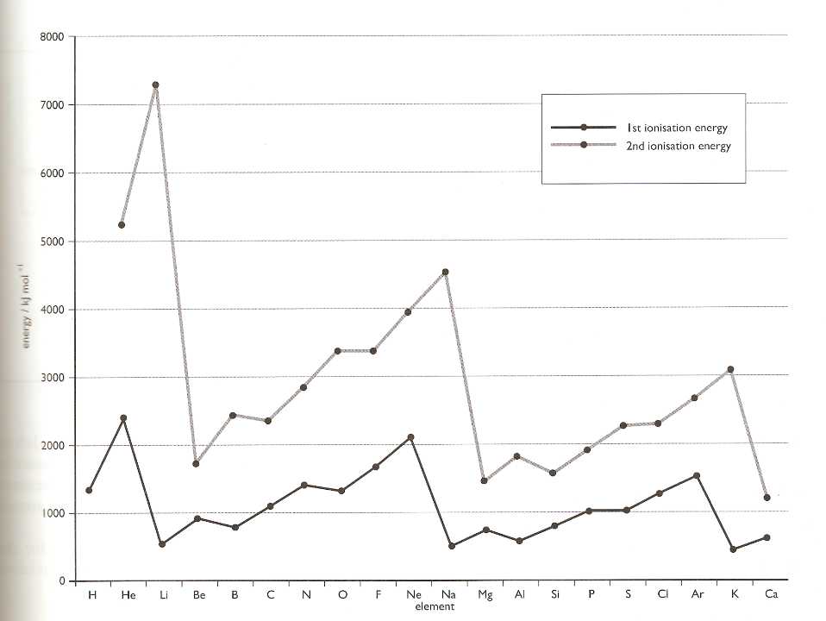






First and Second ionisation energies of the first 20 elements
Adapted from New Higher Chemistry E Allan J Harris
In each period there is an overall increase peaking at the noble gas

Slide 19

First and Second ionisation energies of the first 20 elements
Adapted from New Higher Chemistry E Allan J Harris
Down a group first ionisation energy decreases

Slide 20
First and Second ionisation energies of the first 20 elements
Adapted from New Higher Chemistry E Allan J Harris
For each element the second ionisation energy is higher than the first ionisation energy.

Slide 21
First and Second ionisation energies of the first 20 elements
Adapted from New Higher Chemistry E Allan J Harris
It is worth noting the Noble gases have the highest value for each period. This goes some way to explaining the great stability of filled orbital's and the resistance of the Noble gases to form compounds.

Slide 22
First Ionisation Energies (kJ mol⁻¹⁾
Overall increase along period
Li 526 | Be 905 | B 807 | C 1090 | N 1410 | O 1320 | F 1690 | Ne 2090
Na 502 | Mg 744 | Al 584 | Si 792 | P 1020 | S 1010 | Cl 1260 | Ar 1530
K 425 | Ca 596 | Ga 577 | Ge 762 | As 953 | Se 941 | Br 1150 | Kr 1350
Rb 409 | Sr 556 | In 556 | Sn 715 | Sb 816 | Te 870 | I 1020 | Xe 1170
Decrease down group

Slide 23
Trends in Ionisation energy
Across a period ionisation energies increase.
  This is because the nuclear charge increases (greater positive charge on the nucleus) and holds the outer electrons more strongly. More energy needs to be supplied to remove the electron.
  Within each period the noble gas has the highest value for the 1st ionisation energy explaining the stability of full electron shells.
Down a group ionisation energies decrease.
  This is because the outer electrons are further away from the nucleus. The screening effect of the inner electron shells reduces the nuclear attraction for the outer electrons, despite the increased (positive) nuclear charge.

Slide 24
Why is the second ionisation energy of an element always greater than the first ionisation energy?
First ionisation energy – first mole of electrons removed
M_{(g)} → M⁺_{(g)} + e
Second ionisation energy – second mole of electrons removed
M⁺_{(g)} → M²⁺_{(g)} + e
In the second ionisation energy negative electrons are being removed from positive ions rather than neutral atoms.
In the positive ion there is a greater attraction for the electrons so more energy is needed to remove the second mole of electrons.

Slide 25
Why is the second ionisation energy of K much greater than the second ionisation energy of Mg?
K _{(g)} → K⁺ _{(g)} + e
Mg _{(g)} → Mg⁺ _{(g)} + e
2,8,8,1
2,8,1
2,8,8
2,8,2
K⁺ _{(g)} → K²⁺ _{(g)} + e
Mg+ _{(g)} → Mg²⁺ _{(g)} + e
2,8,8
2,8,7
2,8,1
2,8
The second ionisation of K involves removing an electron from a stable electron arrangement.
This requires a lot of energy
The second ionisation of Mg involves removing an electron to form a stable electron arrangement.
This requires less energy

Slide 26
Review
How many moles are there in 1.65 g of RbOH?
Write the electron configuration for Al³⁺ and Cu.
In 5 mol of which substance has the most atoms?
    Ca(OH)₂
    N₂
    C
    CH₃COOH
    They are all the same

Slide 27
Trends in Ionisation energy
Successive ionisation energies increase as the atom becomes more positive.
There is a large jump in ionisation energy when the electron to be removed comes from a new shell, closer to the nucleus.
e.g. between the 2nd and 3rd ionisation energy for
magnesium.
The total energy to remove more than 1 mole of electrons is equal to the sum of each mole added together (as above).

Slide 28
Review
4. The second ionisation energy of sodium is 4560 kJ mol⁻¹. Write the equation which represents the reaction occurring during the second ionisation energy of sodium.
5. The four successive ionisation energies of beryllium are: 900 1760 14800 21000 kJ mol⁻¹. Why is there a very big increase in size between the second and third ionisation energies?

Slide 29
Review
a) Which has the greater value, the first ionisation energy of magnesium or the second ionisation energy of aluminium?
b) Which has the greater value, the third ionisation energy of magnesium or the third ionisation energy of aluminium?
c) Which has the highest second ionisation energy, potassium, calcium or scandium?
d) Which has the highest third ionisation energy, potassium, calcium or scandium?

Slide 30
Electronegativity
Trends in Physical Properties of the Elements
Electronegativity is a measure of an atom’s attraction for the shared pair of electrons in a bond
e
C
H
e
Which atom would have a greater attraction for the electrons in this bond and why?

Slide 31
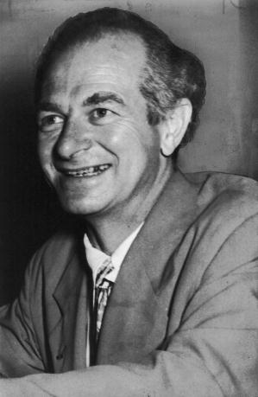
Linus Pauling
Linus Pauling, an American chemist (and winner of two Nobel prizes!) came up with the concept of electronegativity in 1932 to help explain the nature of chemical bonds.
Today we still measure electronegativities of elements using the Pauling scale.
Since fluorine is the most electronegative element (has the greatest attraction for the bonding electrons) he assigned it a value and compared all other elements to fluorine.
Values for electronegativity can be found on page 10 of the data book

Slide 32
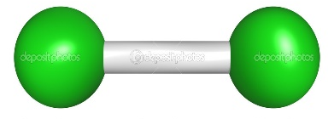

Electronegativities
In the element chlorine both atoms have the same electronegativity so the electrons are shared equally.
In the compound hydrogen iodide the bonded atoms have different electronegativities. The iodine atom has a bigger attraction for the shared electrons than the hydrogen atom. As the electrons are attracted closer to the iodine it becomes slightly negative (δ-) and the hydrogen atom becomes slightly positive (δ+).
δ+
δ-
H
I

Slide 33
Looking across a period
Increasing Electronegativity
Li
Be
B
C
N
F
O
1.0
1.5
2.0
2.5
3.0
3.5
4.0
What are the electronegativities of these elements?
Across a period electronegativity increases
The charge in the nucleus increases across a period.
Greater number of protons = Greater attraction for bonding electrons

Slide 34
Looking down a group
F
4.0
Decreasing Electronegativity
Cl
3.0
What are the electronegativities of these halogens?
Br
2.8
I
2.6
Down a group electronegativity decreases
Atoms have a bigger radius (more electron shells)
The positive charge of the nucleus is further away from the bonding electrons and is shielded by the extra electron shells.

Slide 35
The trend in electronegativity is:
Across a period, electronegativity increases.
This is because the nuclear charge increases, attracting the electrons more strongly to the nucleus. As a result, the electronegativity increases.
Down a group, electronegativity decreases.
Going down the group, the nuclear charge increases but the number of electron shells also increases. As a result of ‘shielding’ and the increased distance the outer shell is from the nucleus, electronegativity decreases.

Slide 36
To Do
Lucarelli Chapter 9
Pearson Chapter 3
STAWA Sets 9-11, *1-3*

Slide 37
Internet Links – Trends in the Periodic Table
Chemical bonds: types of bonds Explores how different types of bonds are formed due to variations in the electronegativity of the bonded atoms. The distortion of the orbitals and the polarity of the bond is also displayed.
Linus Pauling (1901-1994) An account of the life and work of the Nobel Prize-winning chemist, Linus Pauling.
Periodic Table of Data Visual database of the physical and thermochemical properties of the chemical elements which allows the user to plot graphs and tables, play games and view diagrams.

